Slide 1
K-means Clustering
Presented by:
Shubhangi Rokade(36066)

Slide 2

K-Means Clustering
K-Means Clustering: In data mining, k-means clustering is a method of cluster analysis which aims to partition n observations into k clusters in which each observation belongs to the cluster with the nearest mean.
This results in a partitioning of the data space into cells.
Simple iterative method
User provides “K”

Slide 3
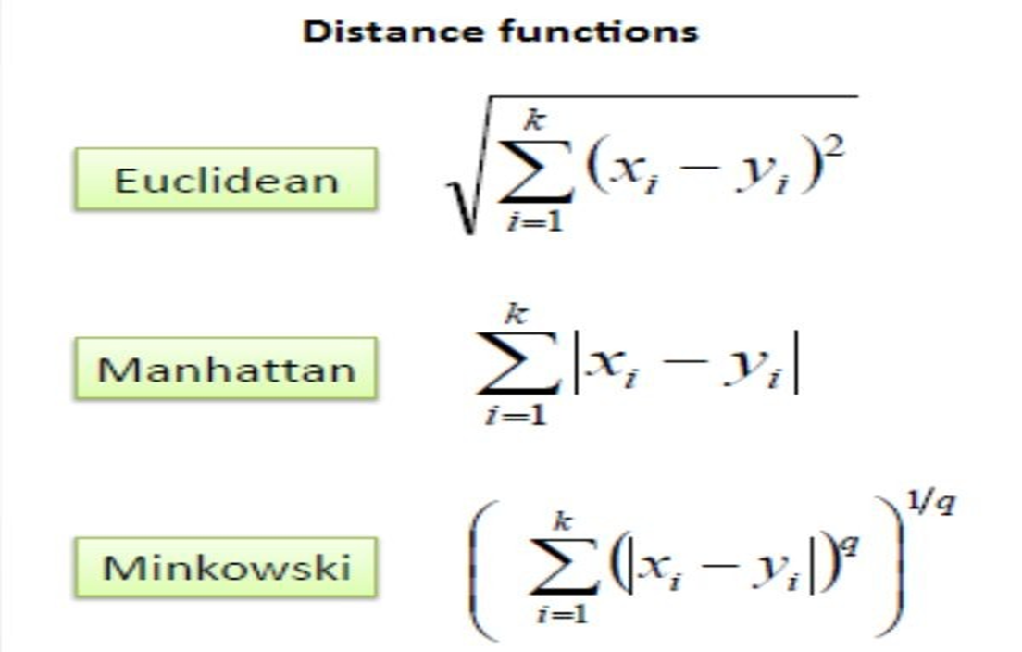
Distance measures

Slide 4

squared Euclidean
The most well-known distance used for numerical data is probably the Euclidean distance. This is a special case of the distance when k = 2. Euclidean distance performs well when deployed to datasets that include compact or isolated clusters . Although Euclidean distance is very common in clustering, it has a drawback: if two data vectors have no attribute values in common, they may have a smaller distance than the other pair of data vectors containing the same attribute values .

Slide 5

Manhattan distance
Manhattan distance is a special case of the distance at m = 1. Like its parent, Manhattan is sensitive to outliers. When this distance measure is used in clustering algorithms, the shape of clusters is hyper-rectangular.

Slide 6
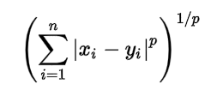
Minkowski Distance
Minkowski distance is a metric in a normed vector space. Minkowski distance is used for distance similarity of vector. Given two or more vectors, find distance similarity of these vectors. Mainly, Minkowski distance is applied in machine learning to find out distance similarity

Slide 7
Algorithm
Initialize k points, called the ‘centroid’, randomly or from the data set.
Data Assignment Step – Group all data points individually with its nearest centroid to form the clusters.
Centroid Update Step – Calculate the value of centroid that is the average of items belonging to each cluster.
Reiterate step 2 and 3, till the centroid value remains constant between consecutive iterations.

Slide 8
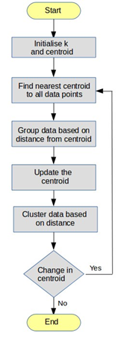
Flow Chart

Slide 9
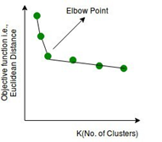
Choosing K Value
In general, there is no method for determining the value of K, but an approximation k value shall be estimated by applying different k values and projecting the results into the graph as shown below. Variance as a function of K is plotted and the “elbow point,” where the rate of decrease sharply shifts, can be used to find K. The elbow in the fig signifies the optimal k-value (number of clusters).

Slide 10
Comments on the K-Means Method
• Strength
– Relatively efficient: where n is # instances, c is # clusters, and t is # iterations. Normally, k, t << n.
– Often terminates at a local optimum. The global optimum may be found using techniques such as: simulated annealing or genetic algorithms
• Weakness
– Applicable only when mean is defined; what about categorical data?
– Need to specify c, the number of clusters, in advance – Unable to handle noisy data and outliers.

Slide 11
Variations of the K-Means Method
A few variants of the k-means which differ in
– Selection of the initial k means
– Dissimilarity calculations
– Strategies to calculate cluster means
• Handling categorical data: k-modes (Huang’98)
– Replacing means of clusters with modes
– Using new dissimilarity measures to deal with categorical objects

Slide 12
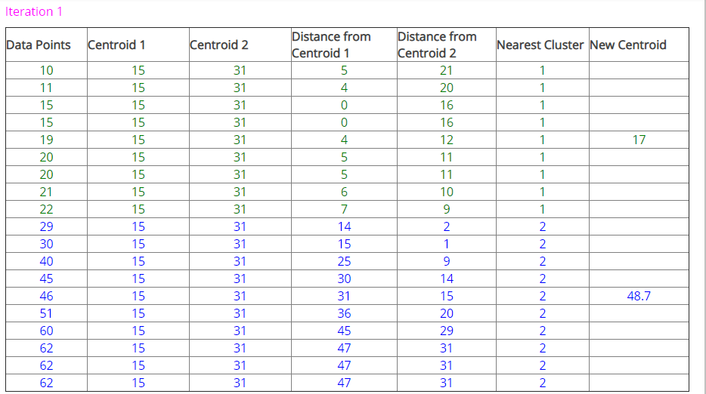
Example

Slide 13
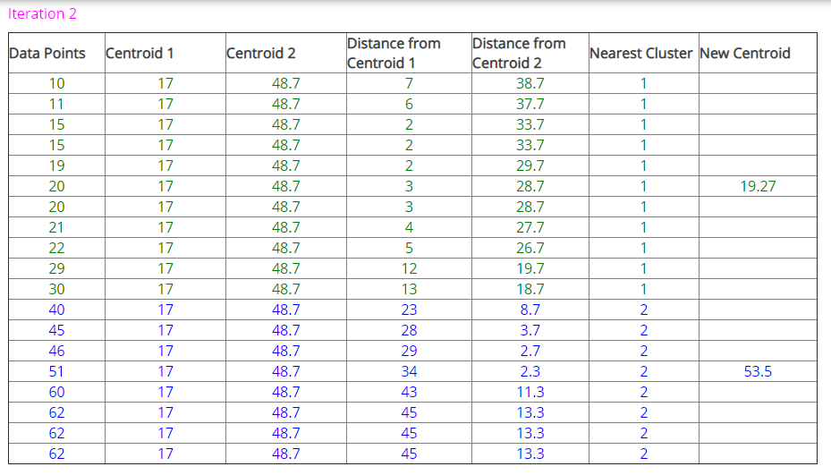
Example

Slide 14
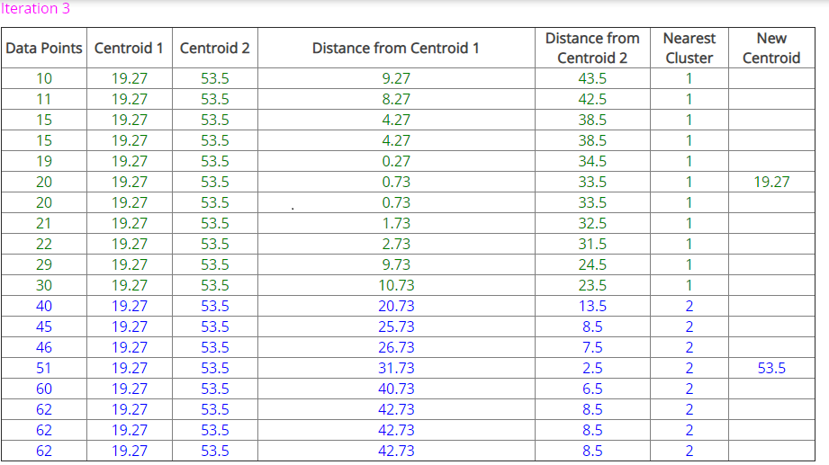
Example

Slide 15
Advantages and Disadvantages
Advantages
Easy implementation with computationally fast and efficient with large number o
f variables
Works well with distinct boundary data sets.
Disadvantages
Difficulty in predicting the exact k-value for unknown data set.
Initial seeds have a strong influence on the final resulting cluster.

Slide 16
Application
1. Document Classification
2. Delivery Store Optimization
3. Identifying Crime Localities
4. Customer Segmentation
5. Fantasy League Stat Analysis
6. Insurance Fraud Detection
7. Rideshare Data Analysis
8. Cyber-Profiling Criminals
9. Call Record Detail Analysis
10. Automatic Clustering of IT Alerts

Slide 17
Thank you

